Slide 1
Exam #2 Review
Wednesday 10/29/2025
William Little
–
Supplemental Instruction
Recording: n/a
– (Achieve question numbers may not correspond to Achieve study guide)

Slide 2
Q0.) Math is…?
Fill in the blank: “Math is ______”
FUN

Slide 3
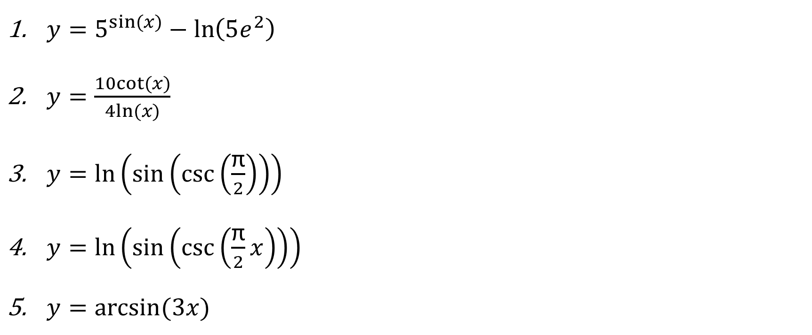
*Q1.) Finding Derivatives
Important question, highly relevant to exam content!
$y=5^{sin⁡(x)}−\ln\left(5e^{2}\right)$
$y=\frac{10cot⁡(x)}{4ln⁡(x)}$
$y=ln\left(\sin\left(\csc\left(\frac{\text{π}}{2}\right)\right)\right)$
$y=ln\left(\sin\left(\csc\left(\frac{\text{π}}{2}x\right)\right)\right)$
$y=arcsin⁡(3x)$

Slide 4
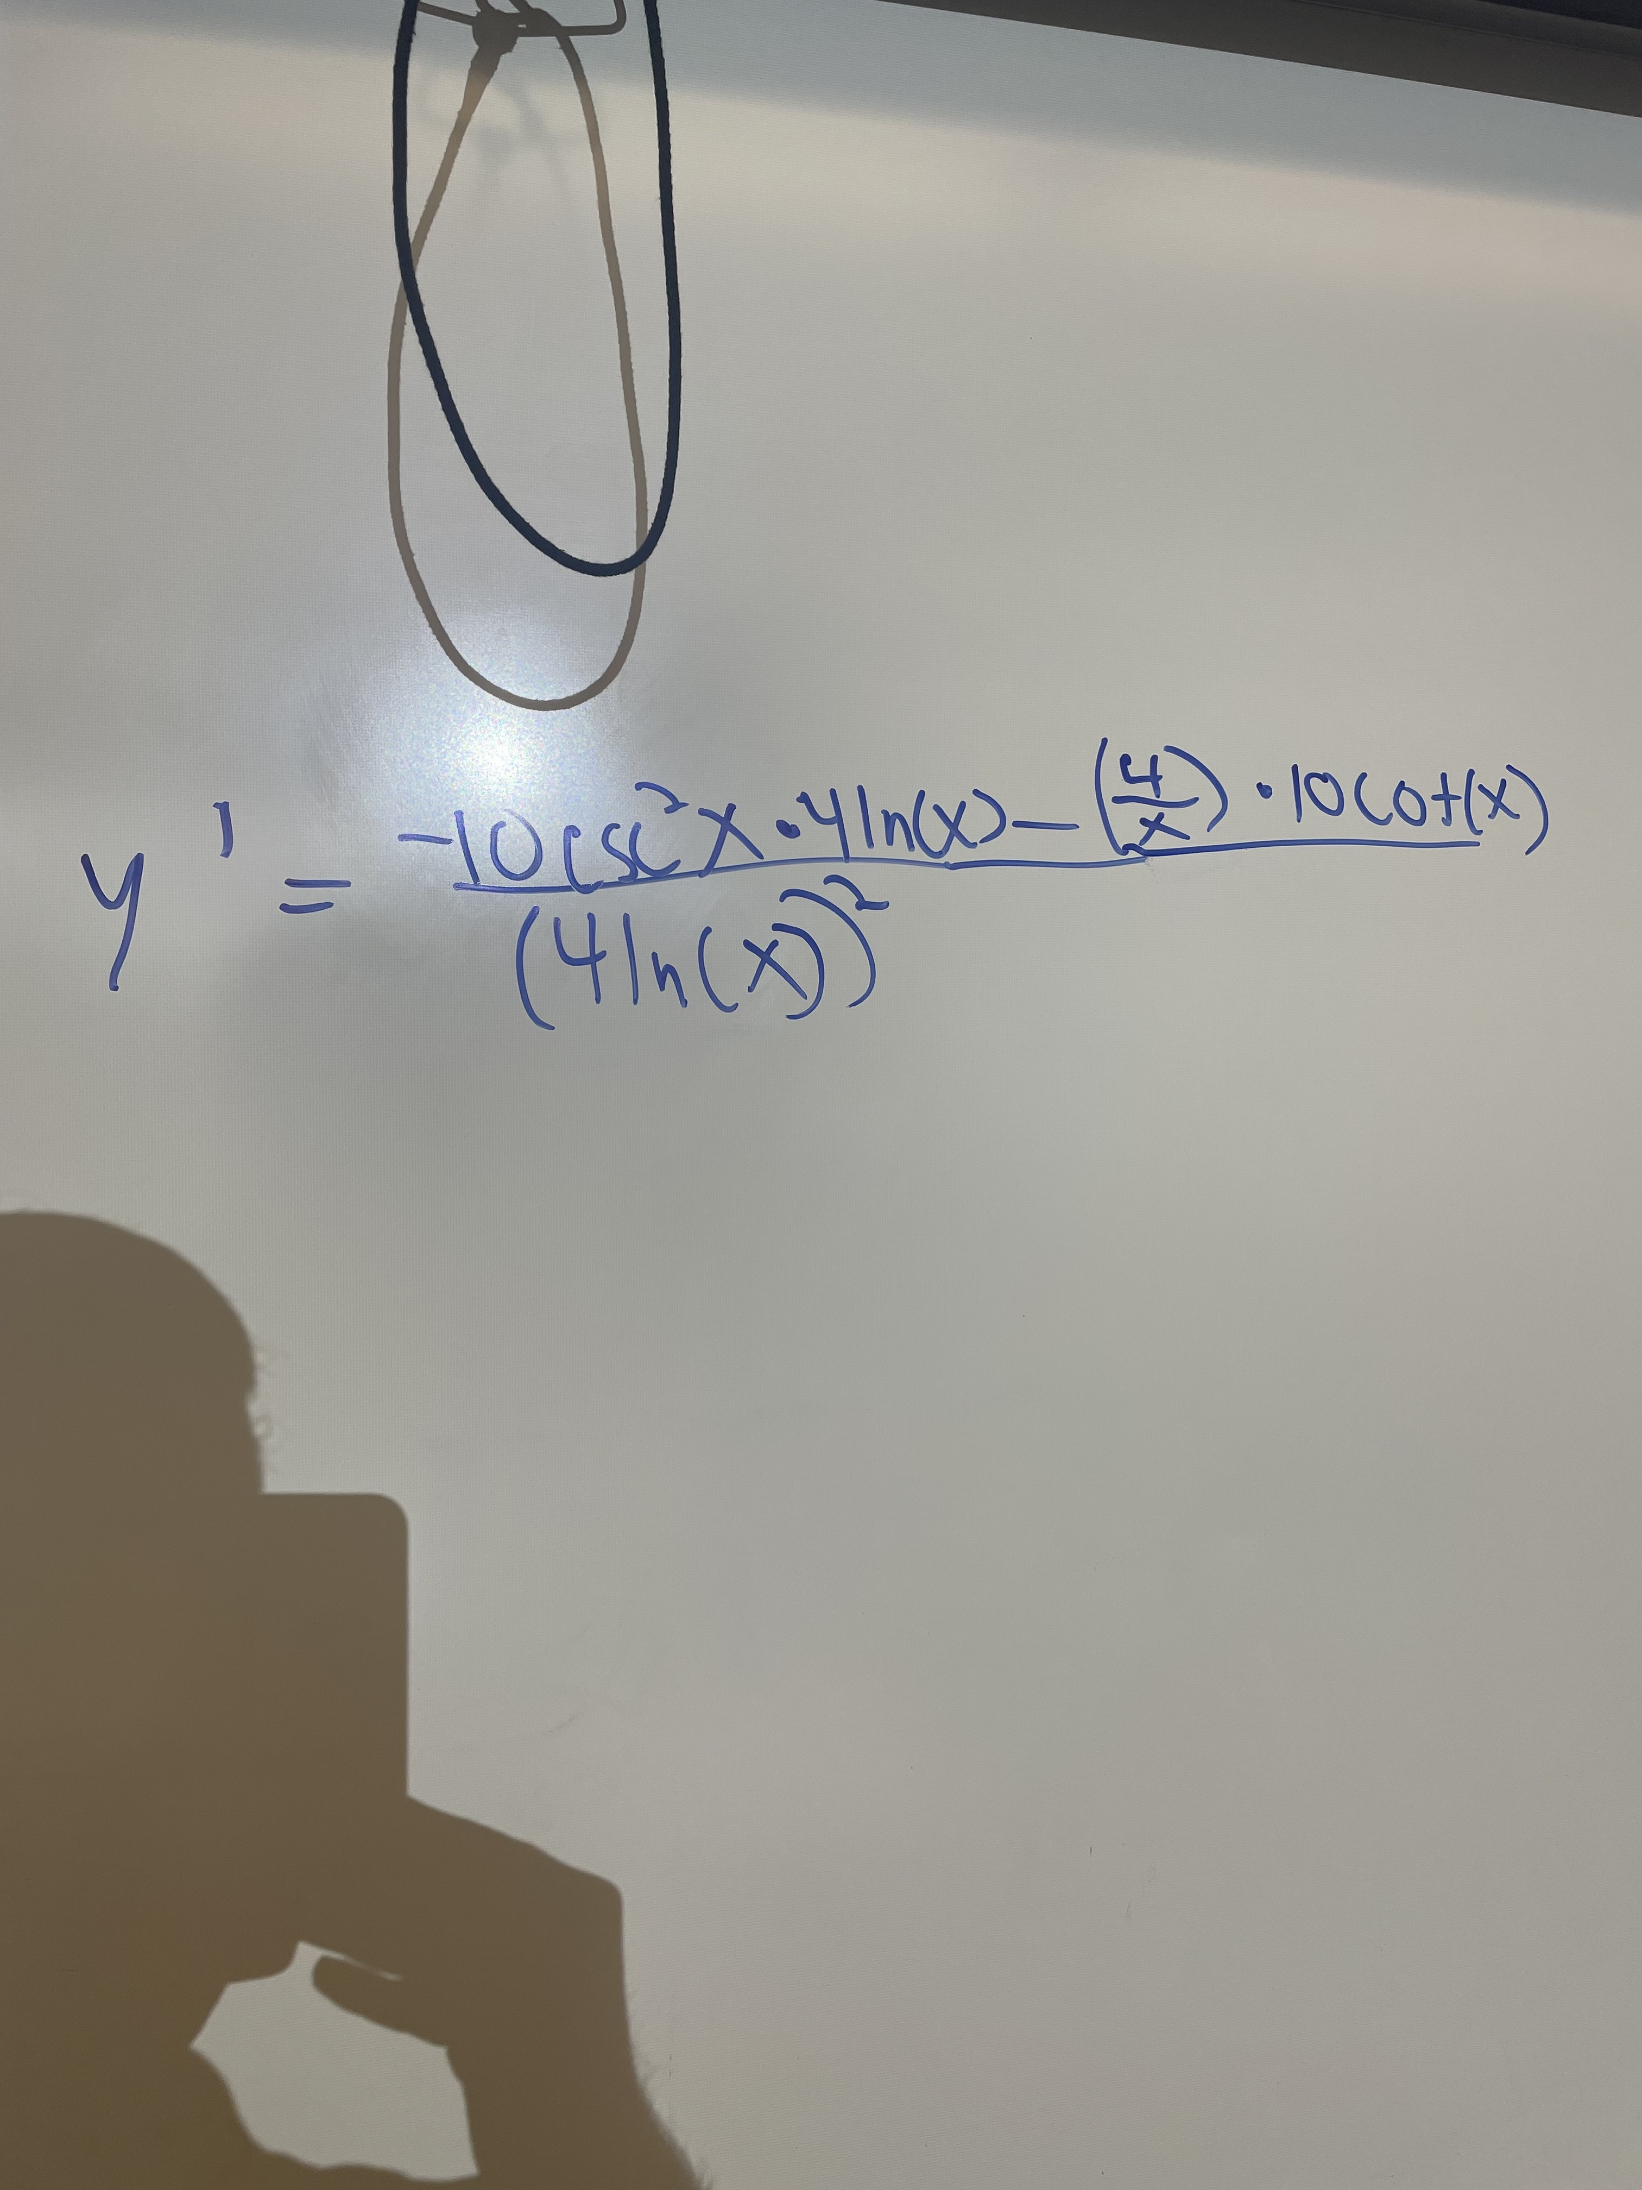
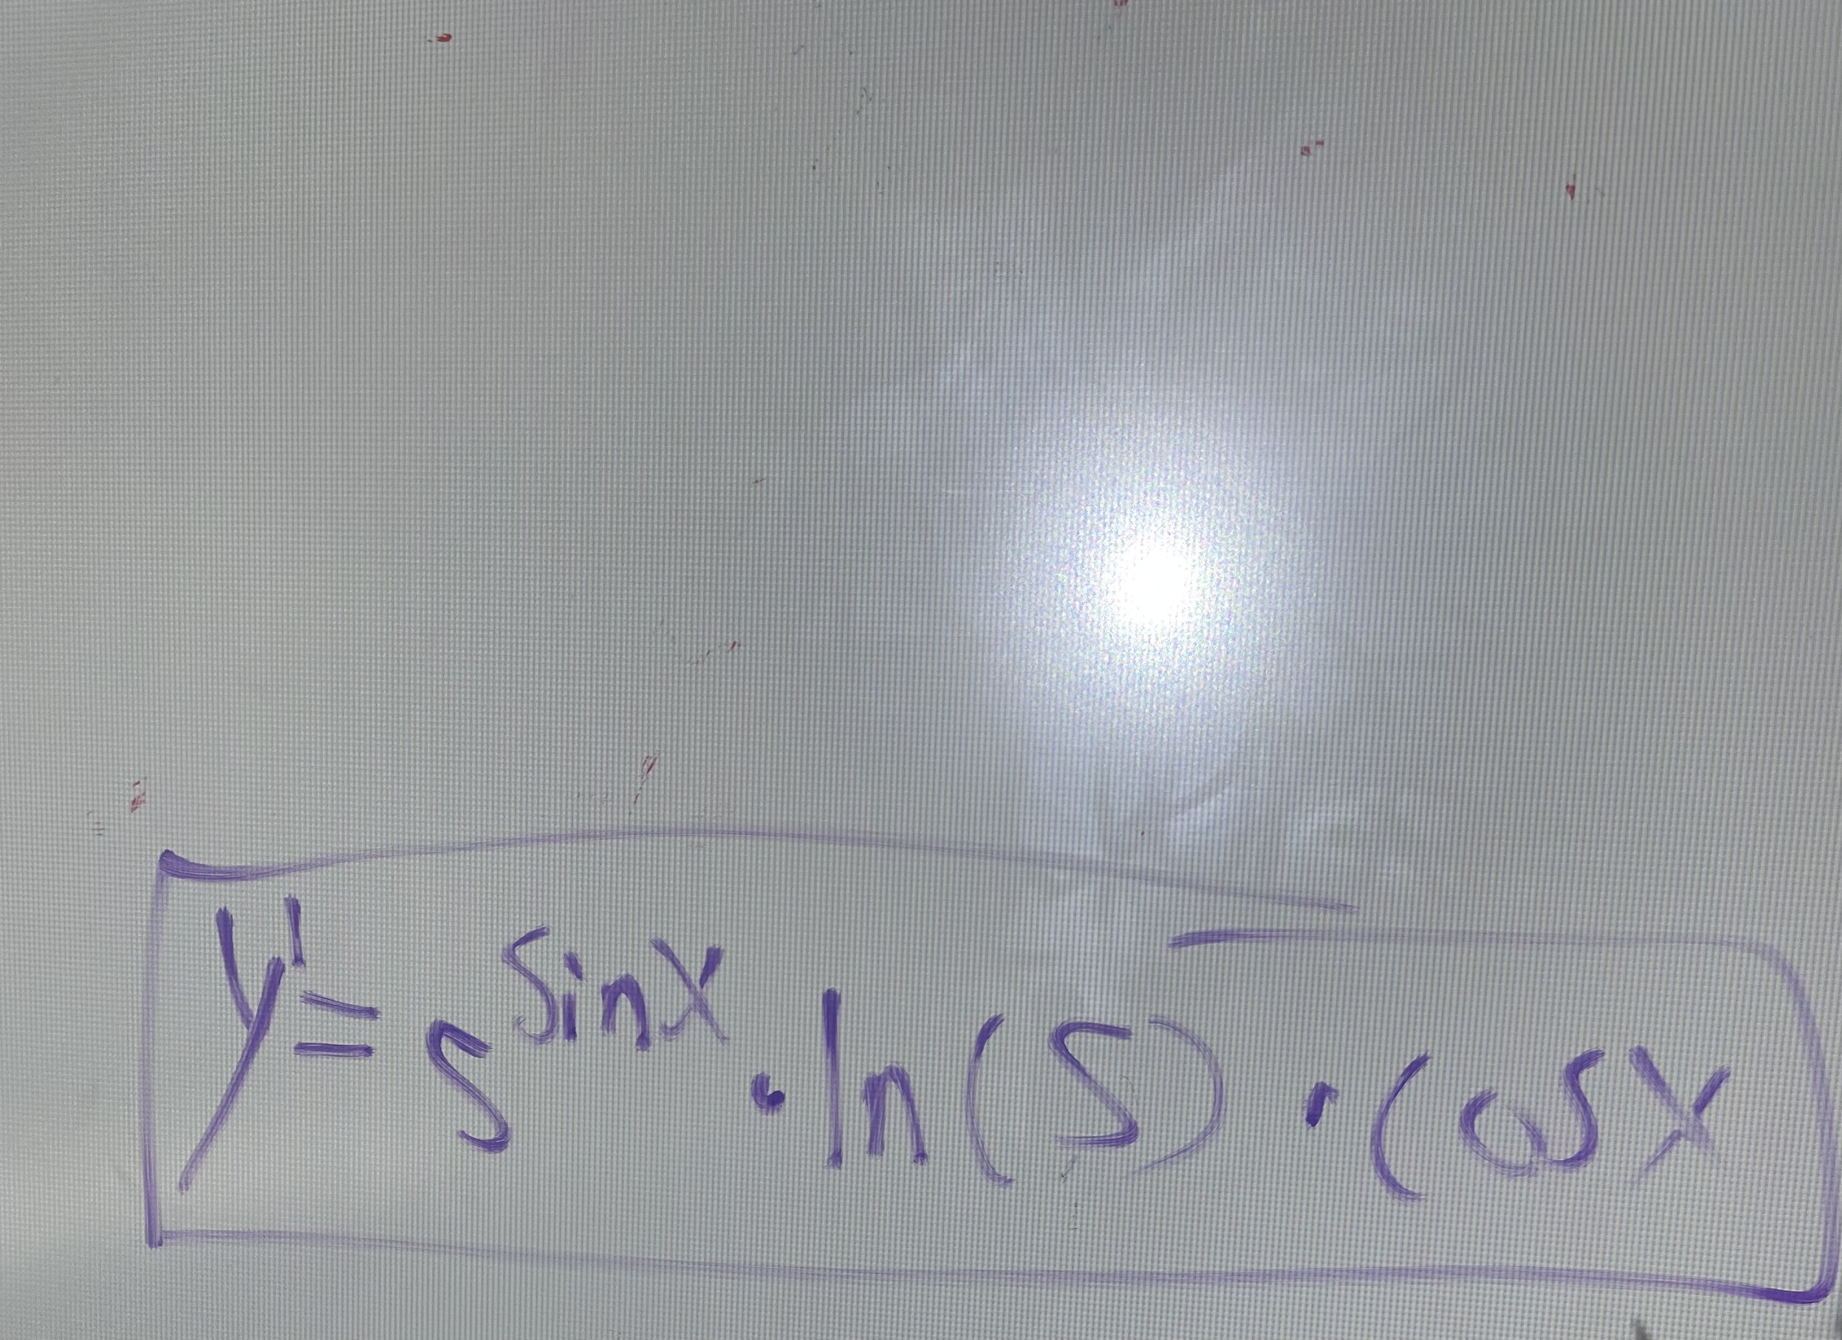
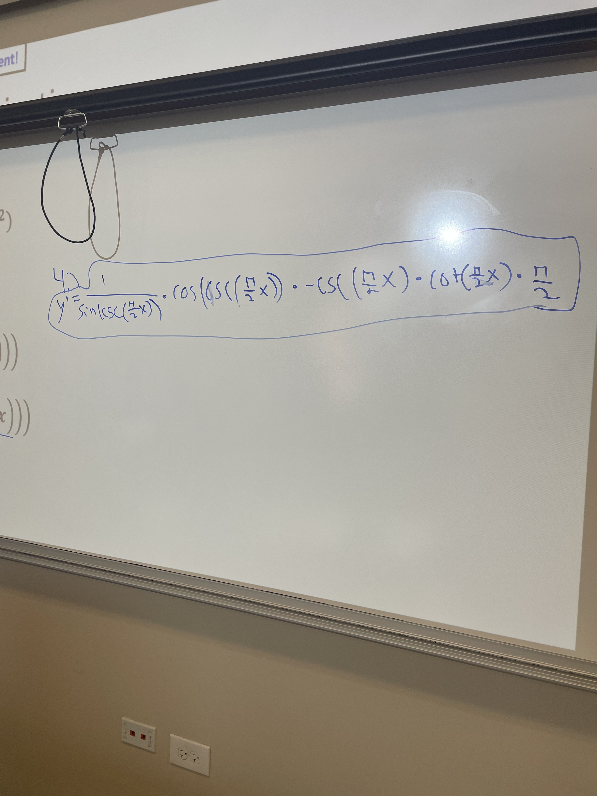
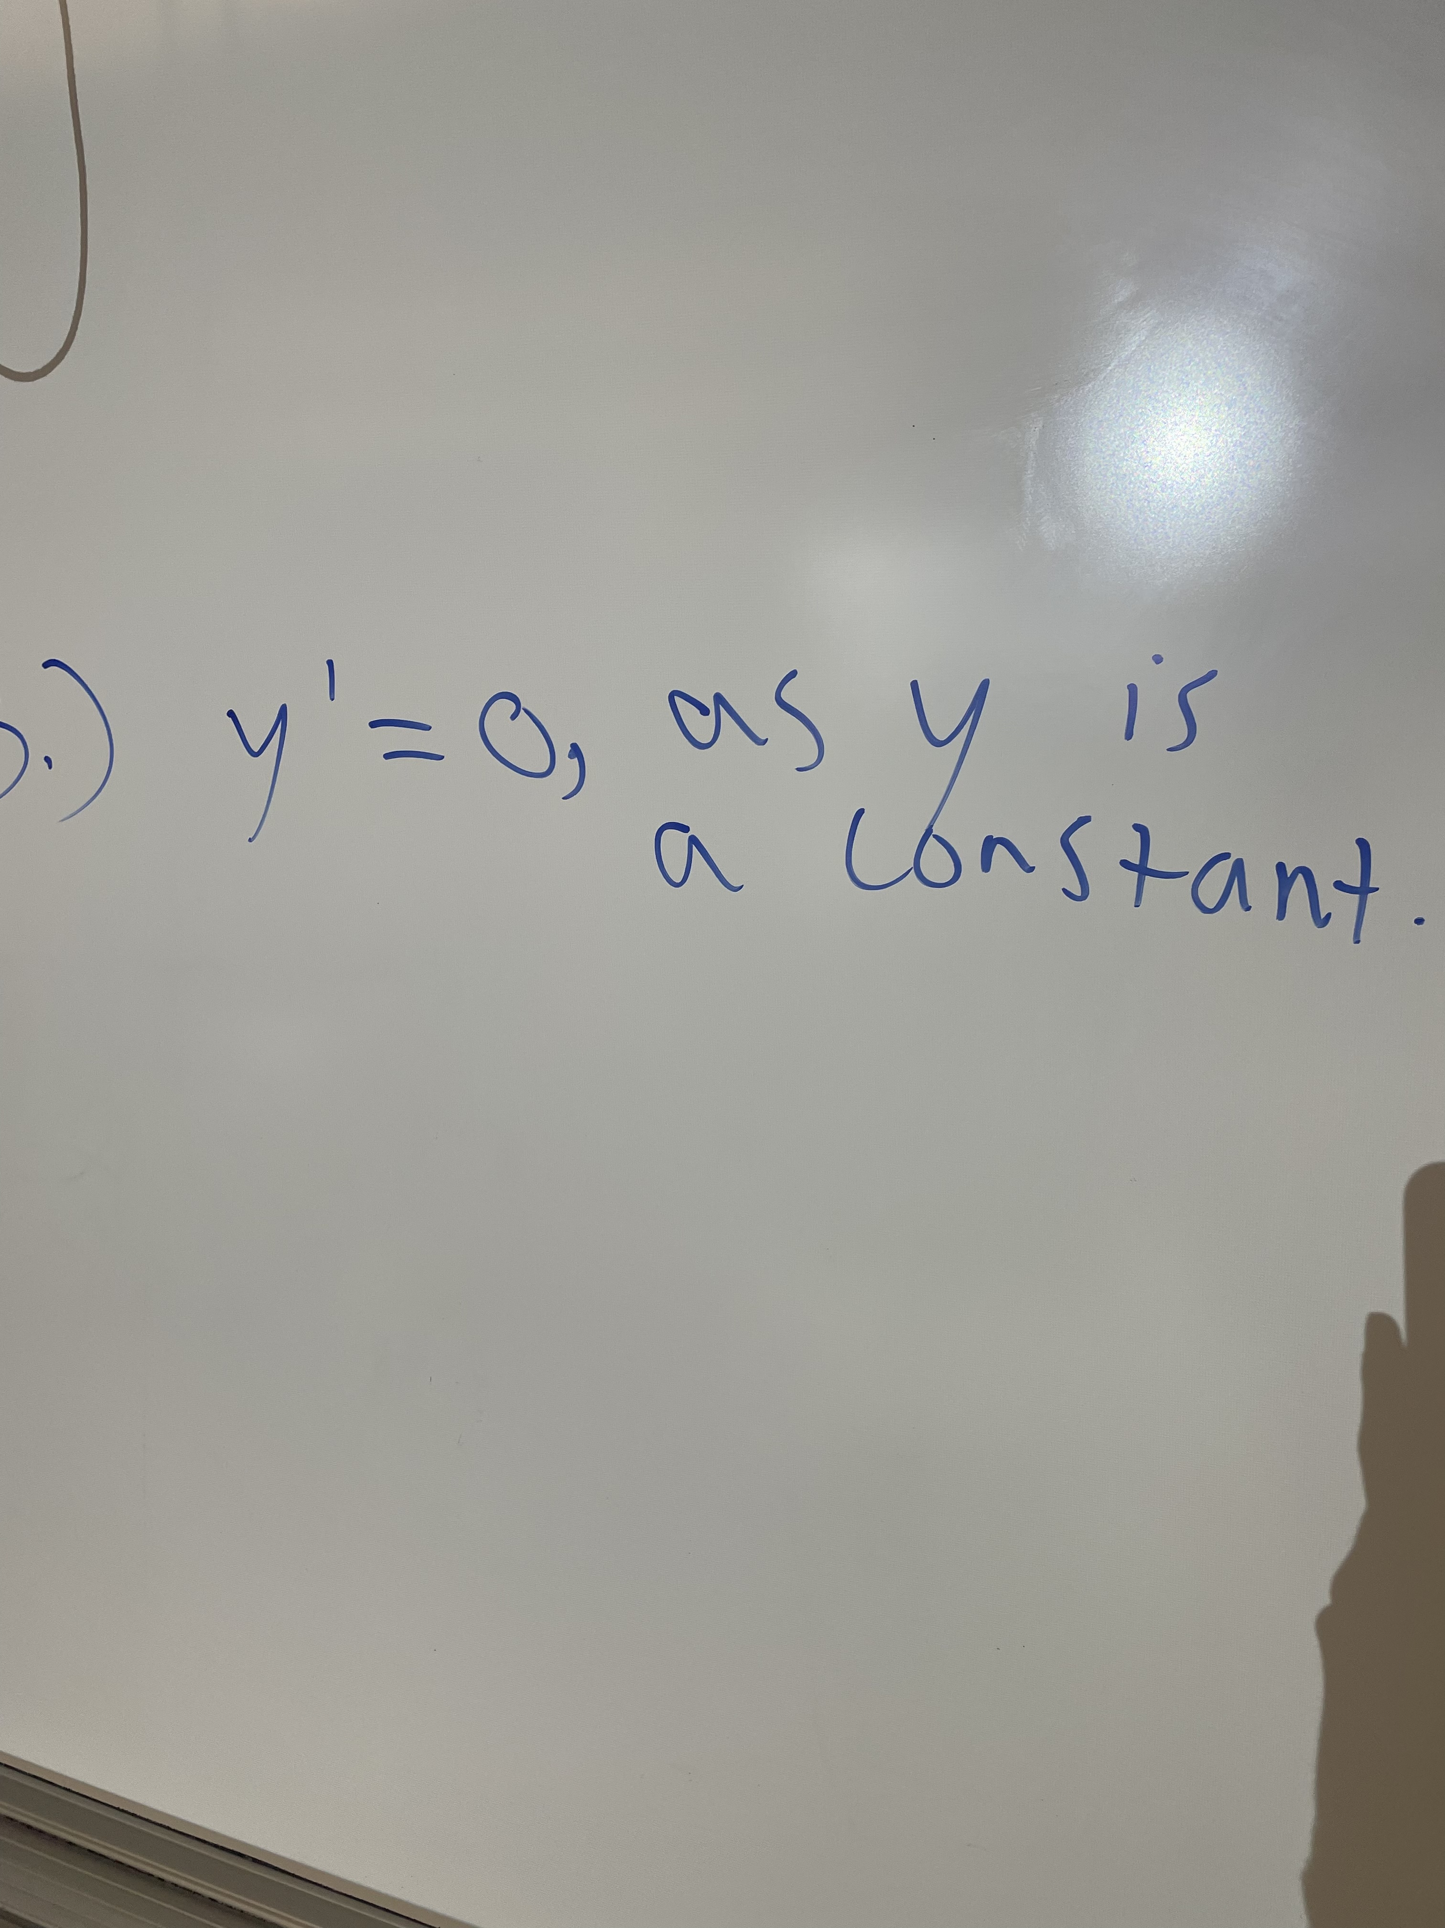
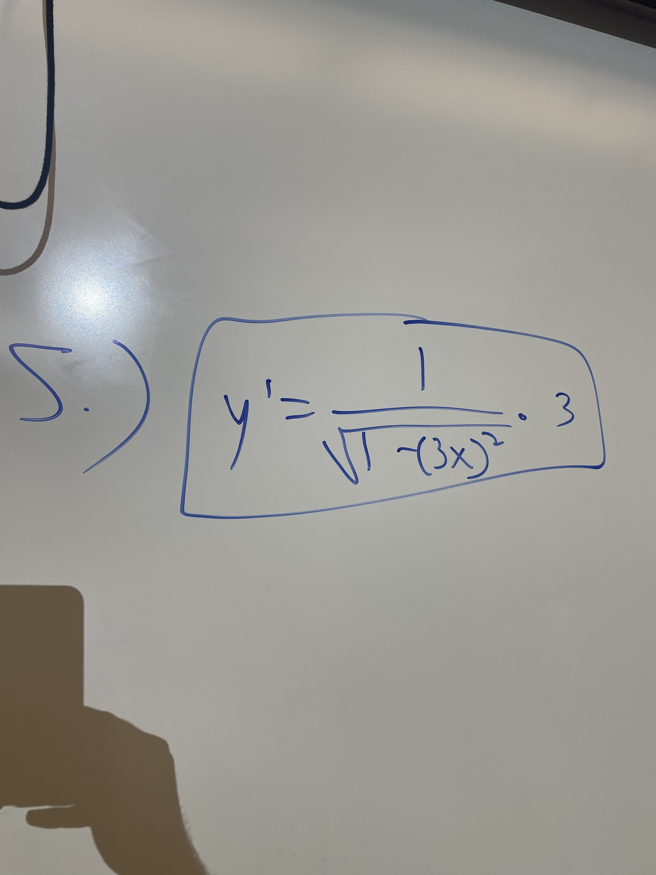
Q1 Answers
2.)
1.)
3.)
4.)
5.)

Slide 5
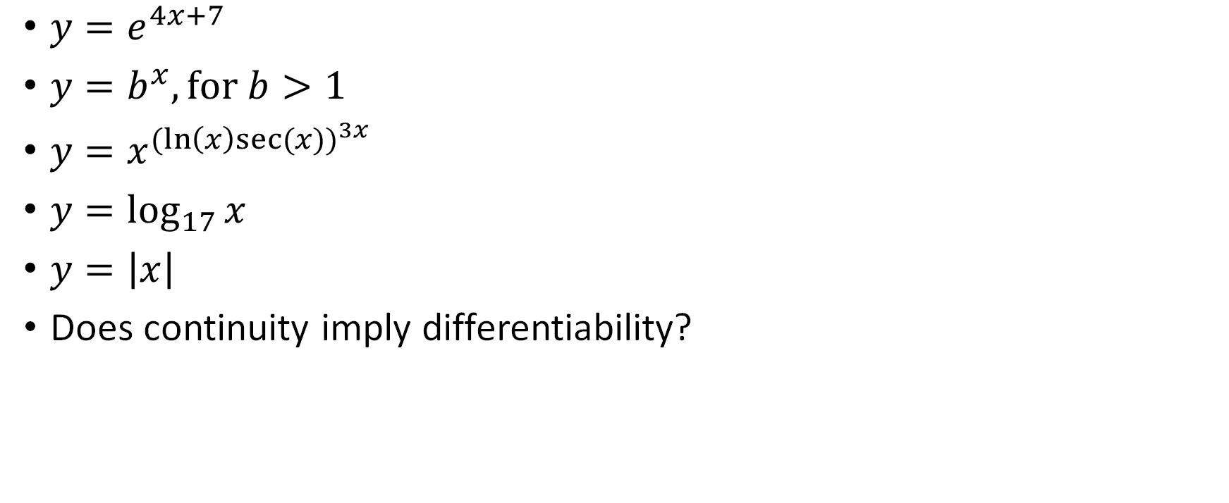
More Derivative Practice
$y=e^{4x+7}$
$y=b^{x}, \text{for} b>1$
$y=x^{{(ln\left(x\right)sec⁡(x))}^{3x}}$
$y=\log_{17}{x}$
$y=\left|x\right|$
Does continuity imply differentiability?

Slide 6
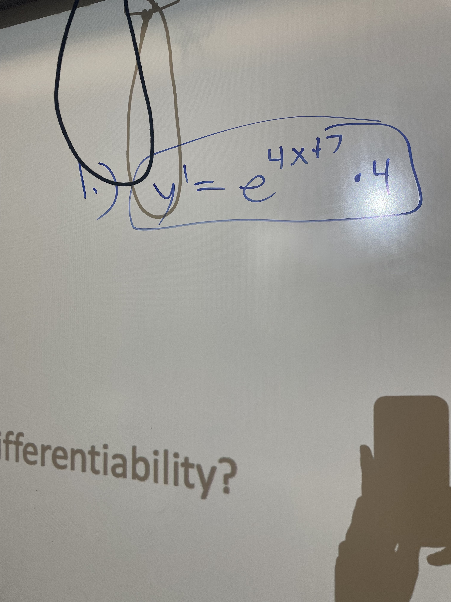
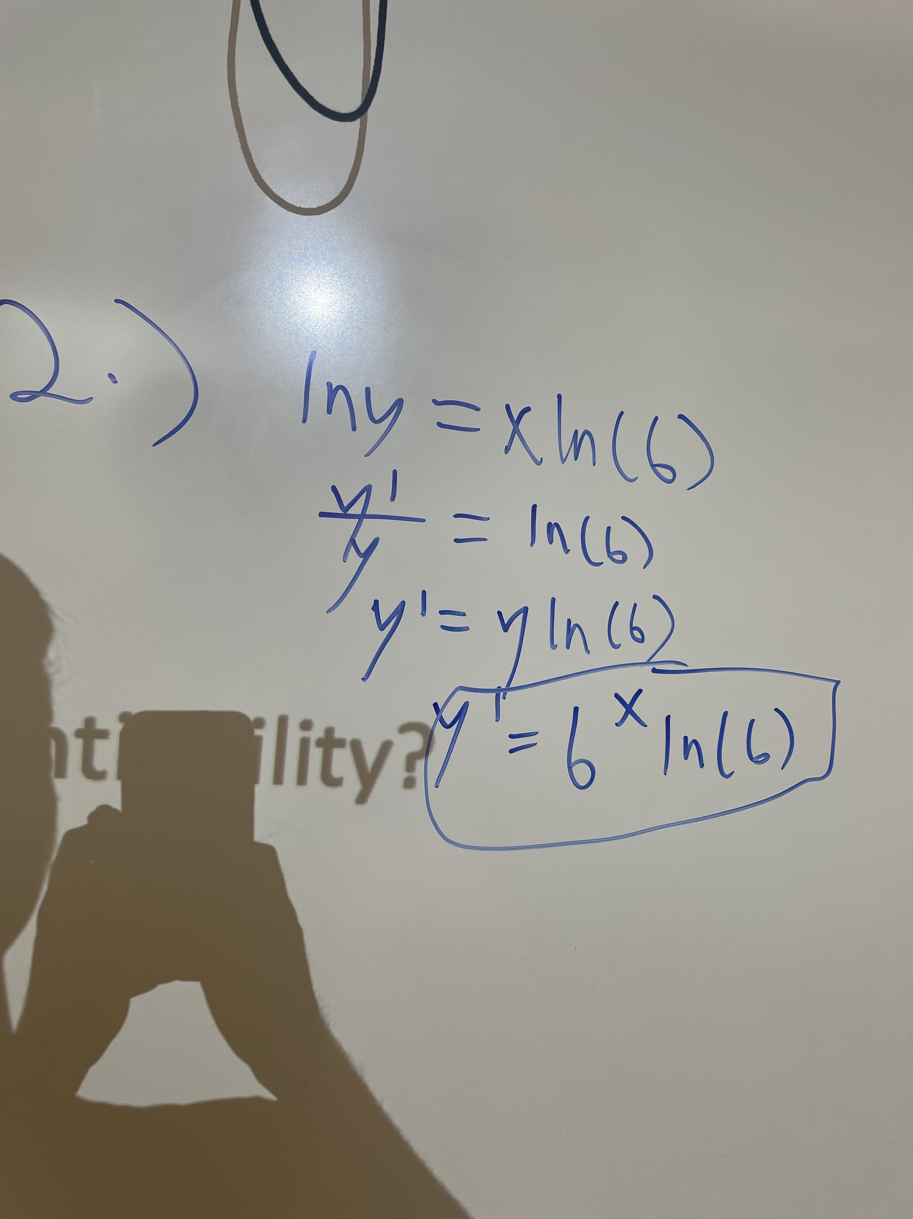
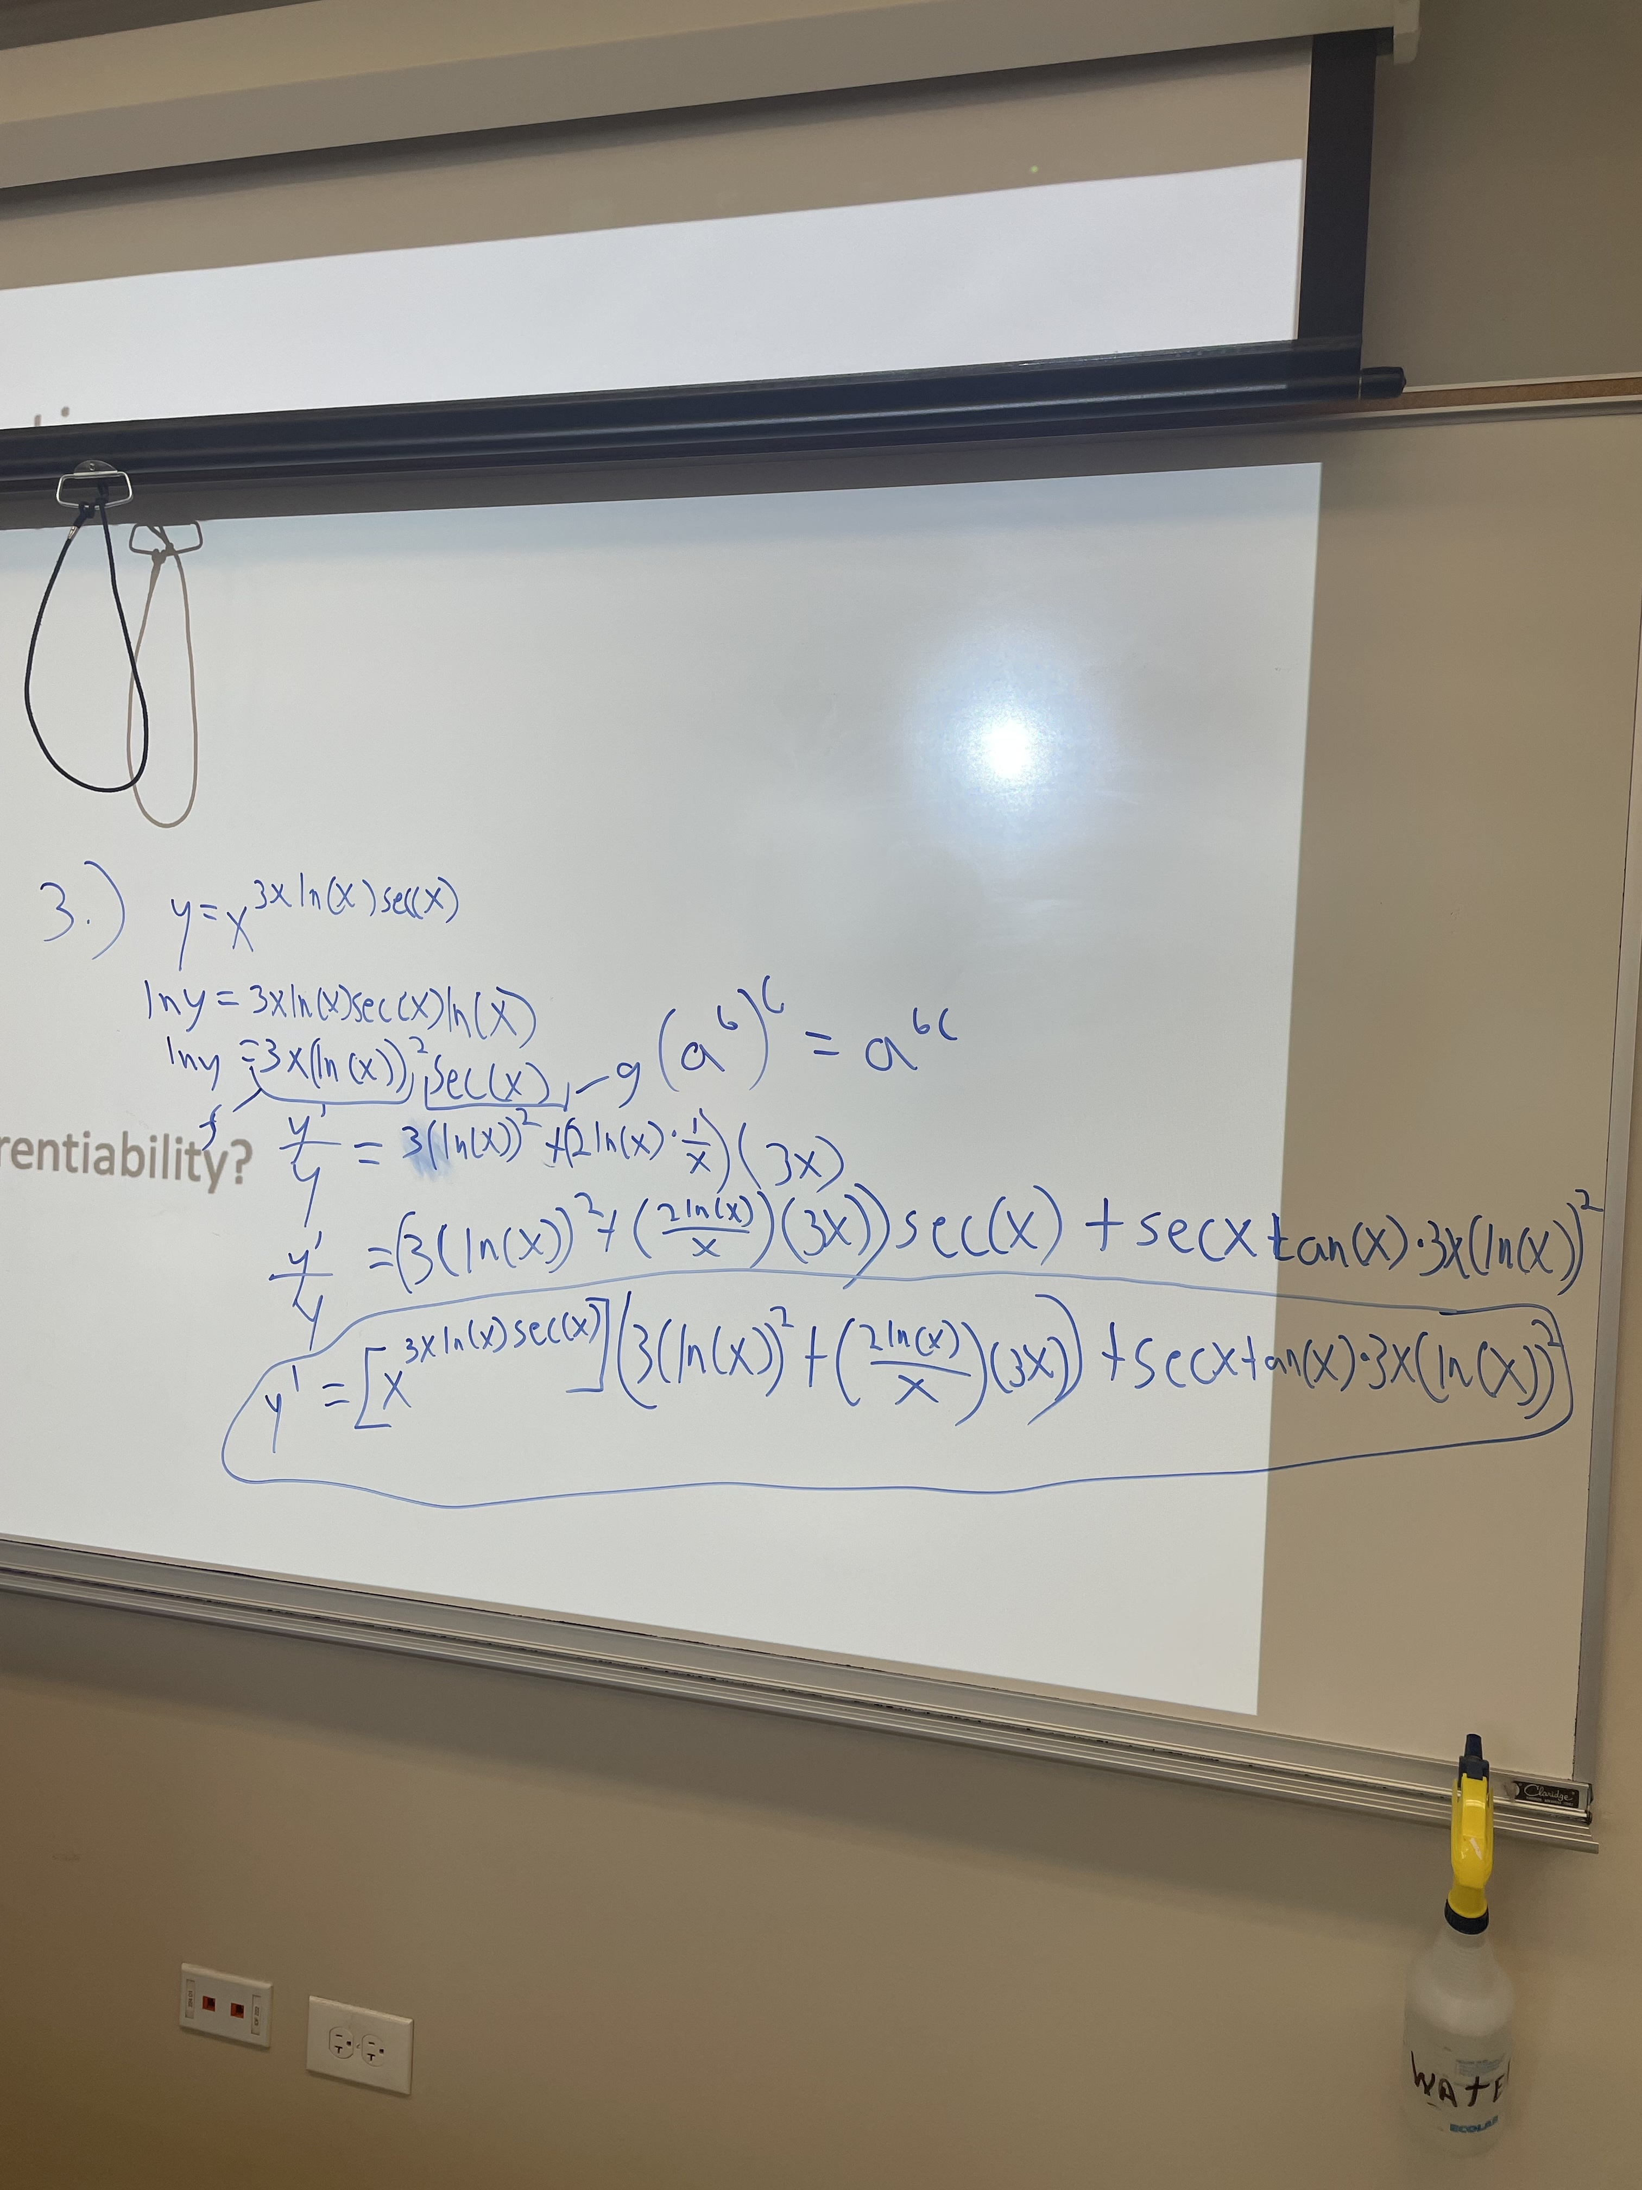
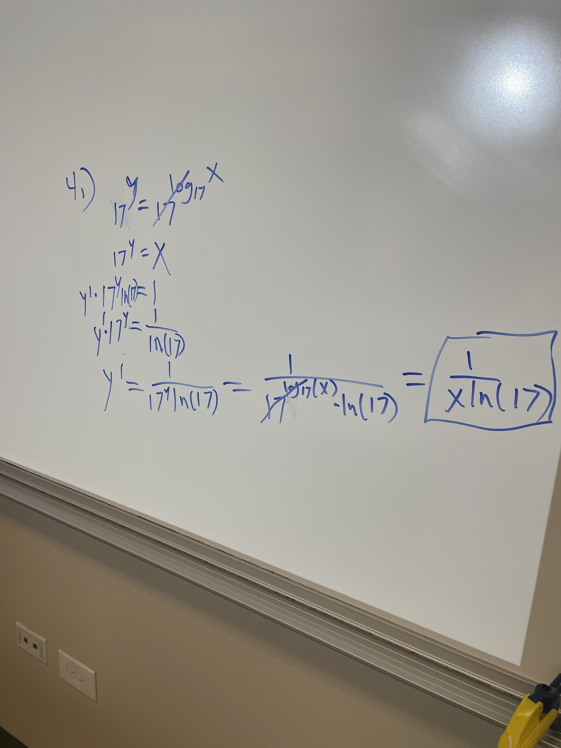
More Derivative Practice Answers
5.) f(x)=|x| is nondifferentiable as f’(x) is undefined at x=0.
6.) No, take for example f(x)=|x|. f(x) is continuous everywhere but is still nondifferentiable.

Slide 7
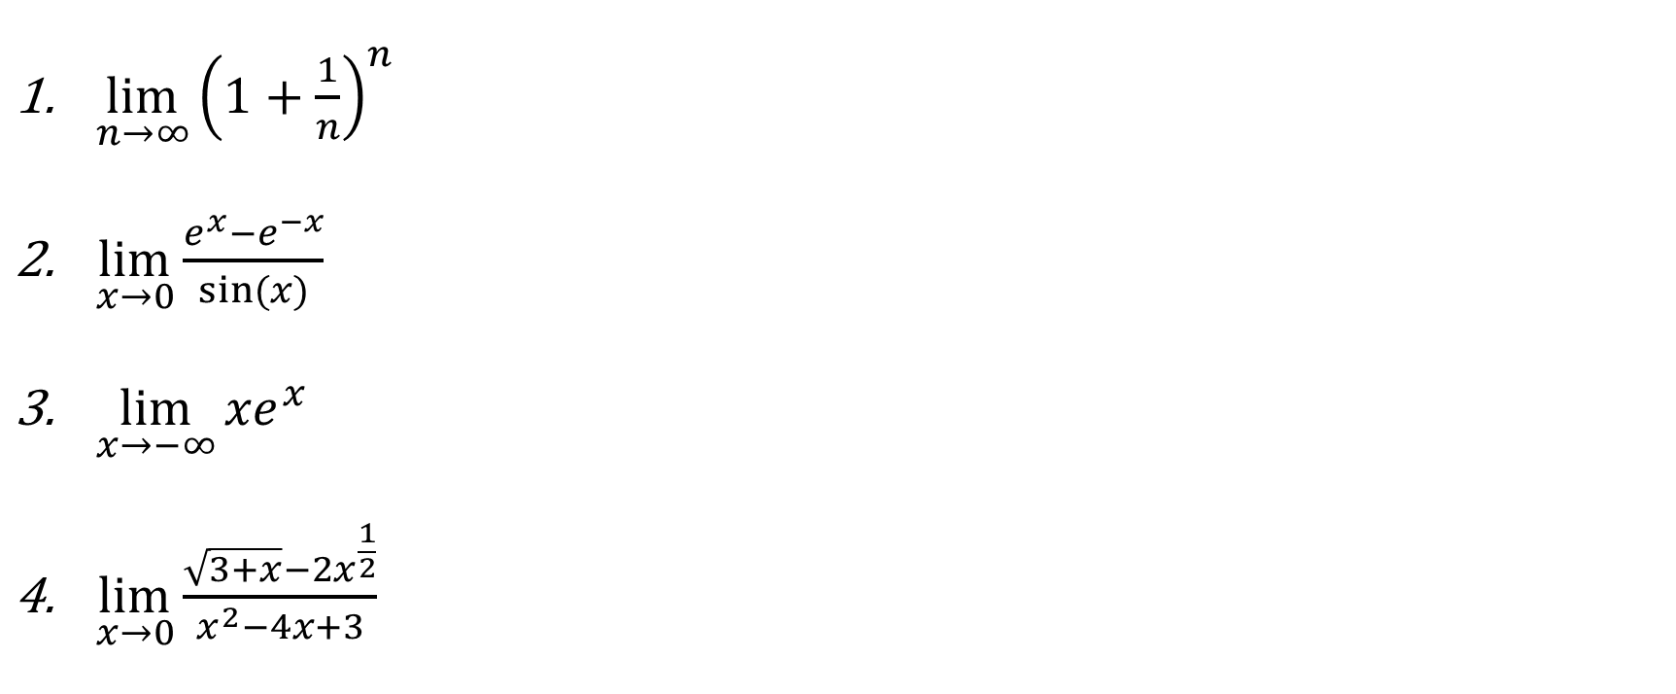
*Q2.) Evaluating Limits
$\lim_{n→∞}{{\left(1+\frac{1}{n}\right)}^{n}}$
$\lim_{x→0}{\frac{e^{x}−e^{−x}}{sin⁡(x)}}$
$\lim_{x→−∞}{{xe}^{x}}$
$\lim_{x→0}\frac{\sqrt{3+x}−2x^{\frac{1}{2}}}{x^{2}−4x+3}$

Slide 8
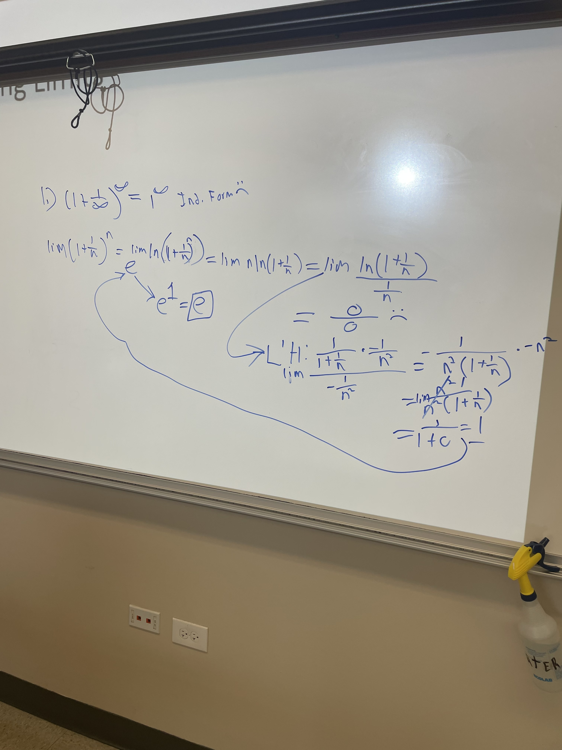
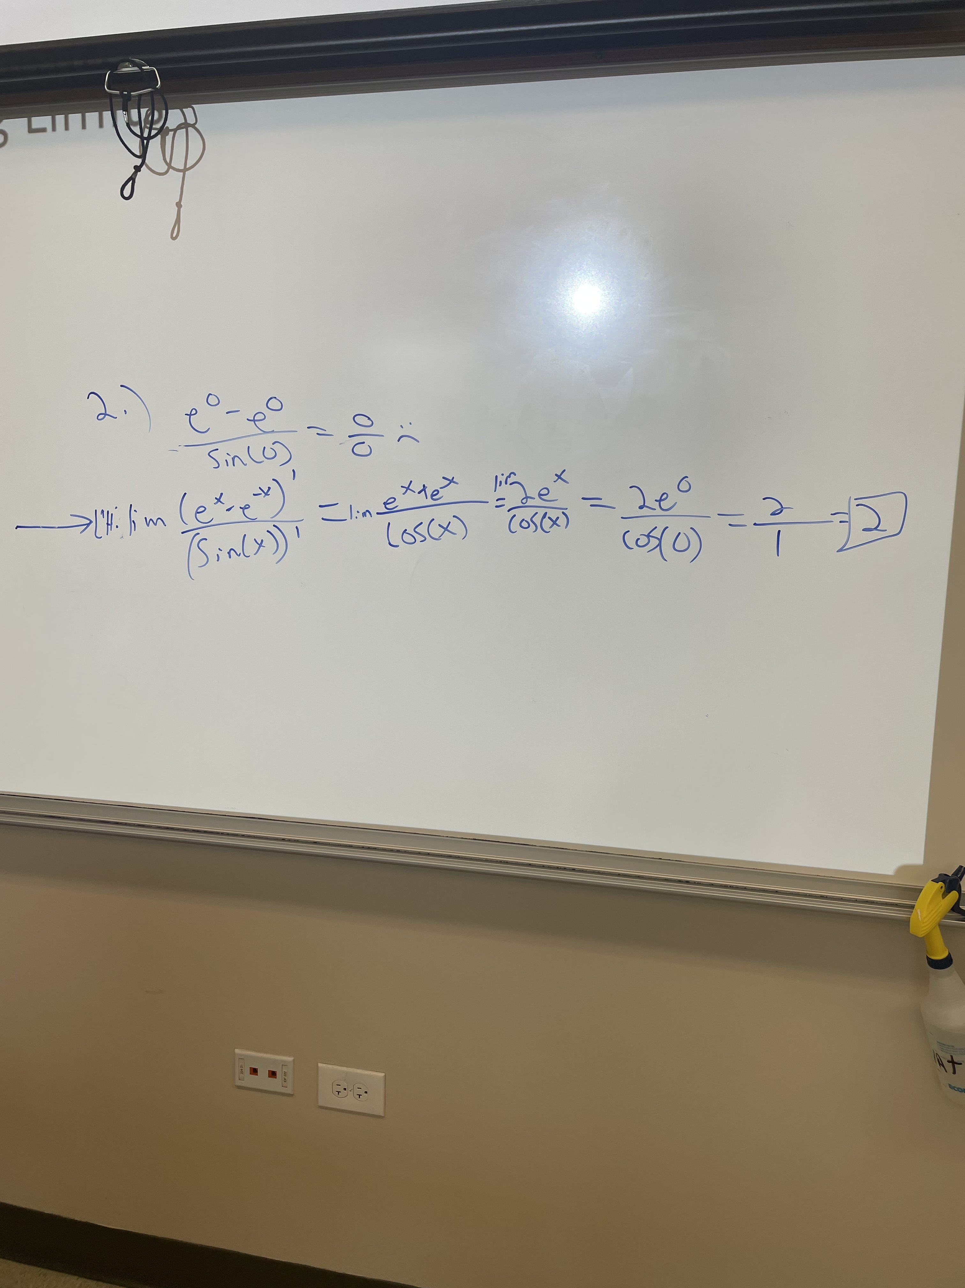
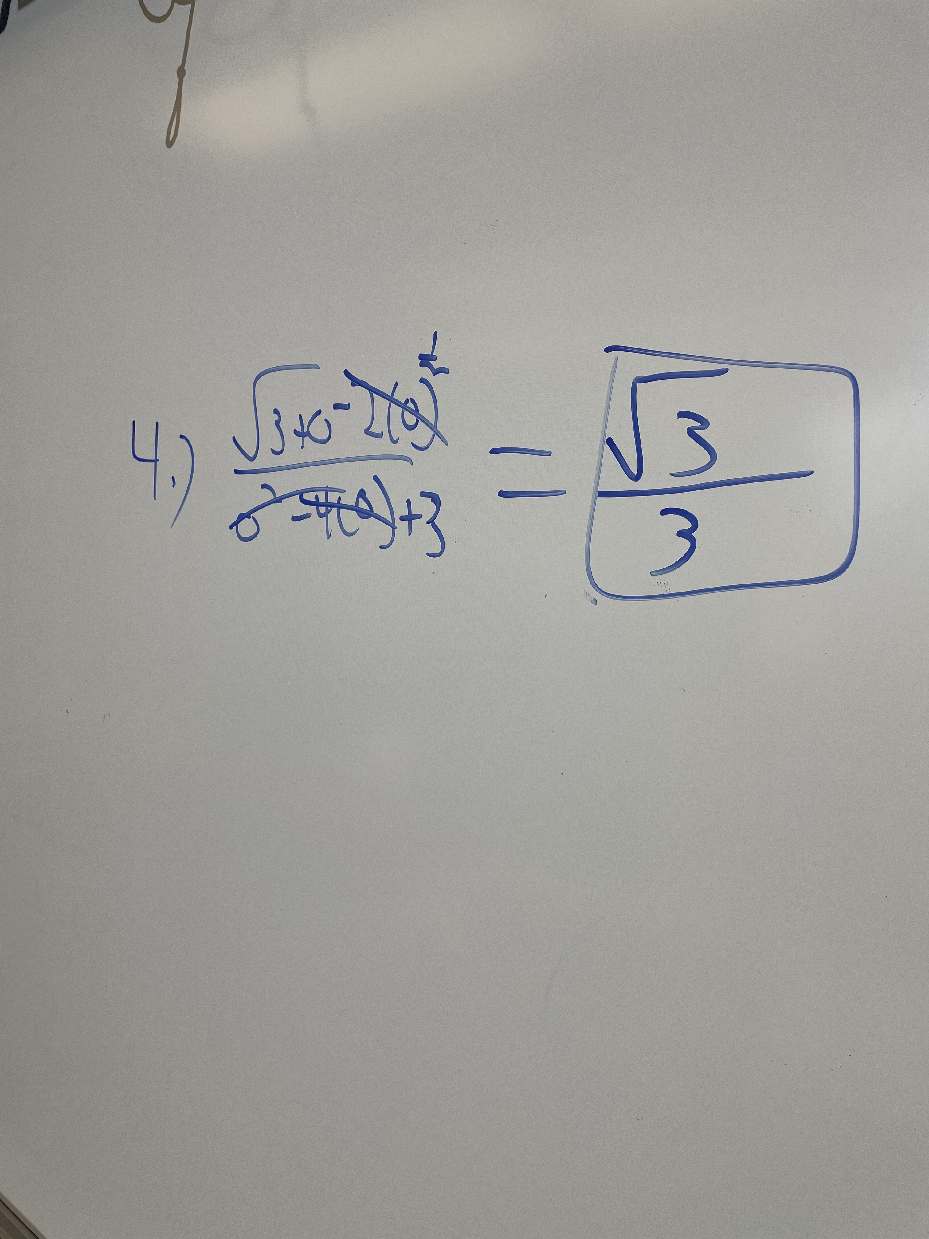
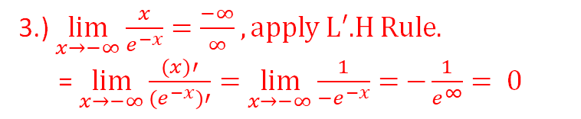
Q2 Answers
3.) $\lim_{x→−∞}{\frac{x}{e^{−x}}=\frac{−∞}{∞},\text{apply} \text{L}\text{′.}\text{H} \text{Rule}.}$
= $\lim_{x→−∞}{\frac{(x)′}{{(e}^{−x})′}=}$ $\lim_{x→−∞}{\frac{1}{{−e}^{−x}}=}$ $−\frac{1}{e^{∞}}= 0$

Slide 9
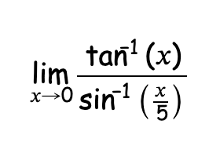
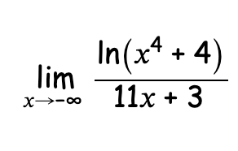
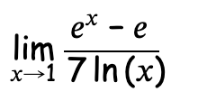
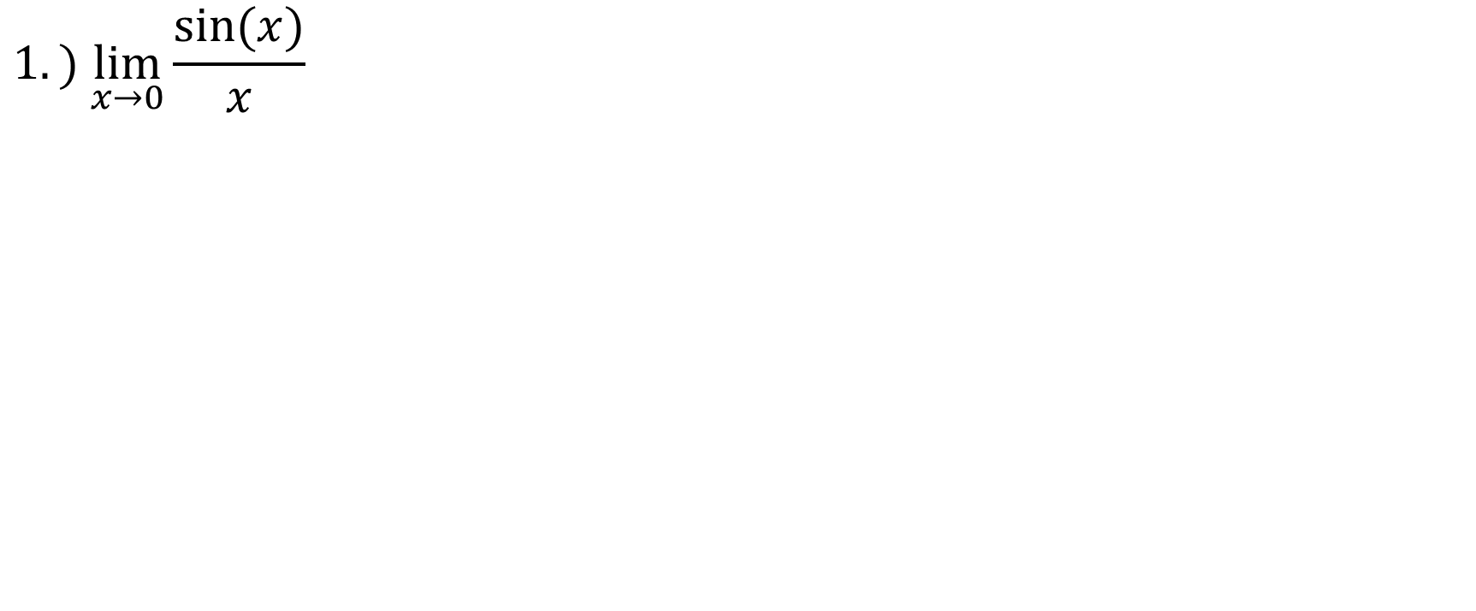
More Limit Practice
$$1.) \lim_{x→0}{\frac{sin⁡(x)}{x}}$$
2.)
4.)
3.)

Slide 10
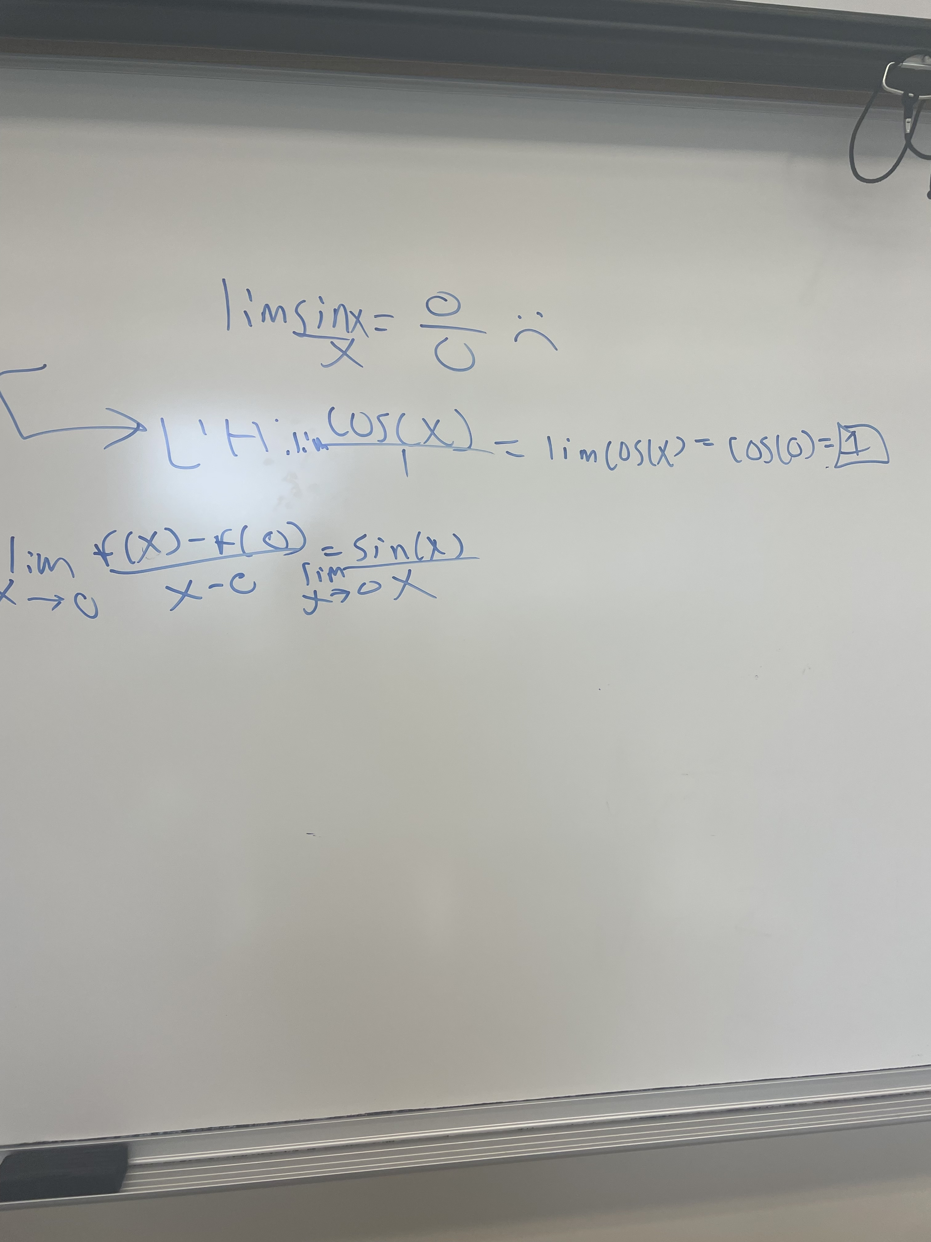
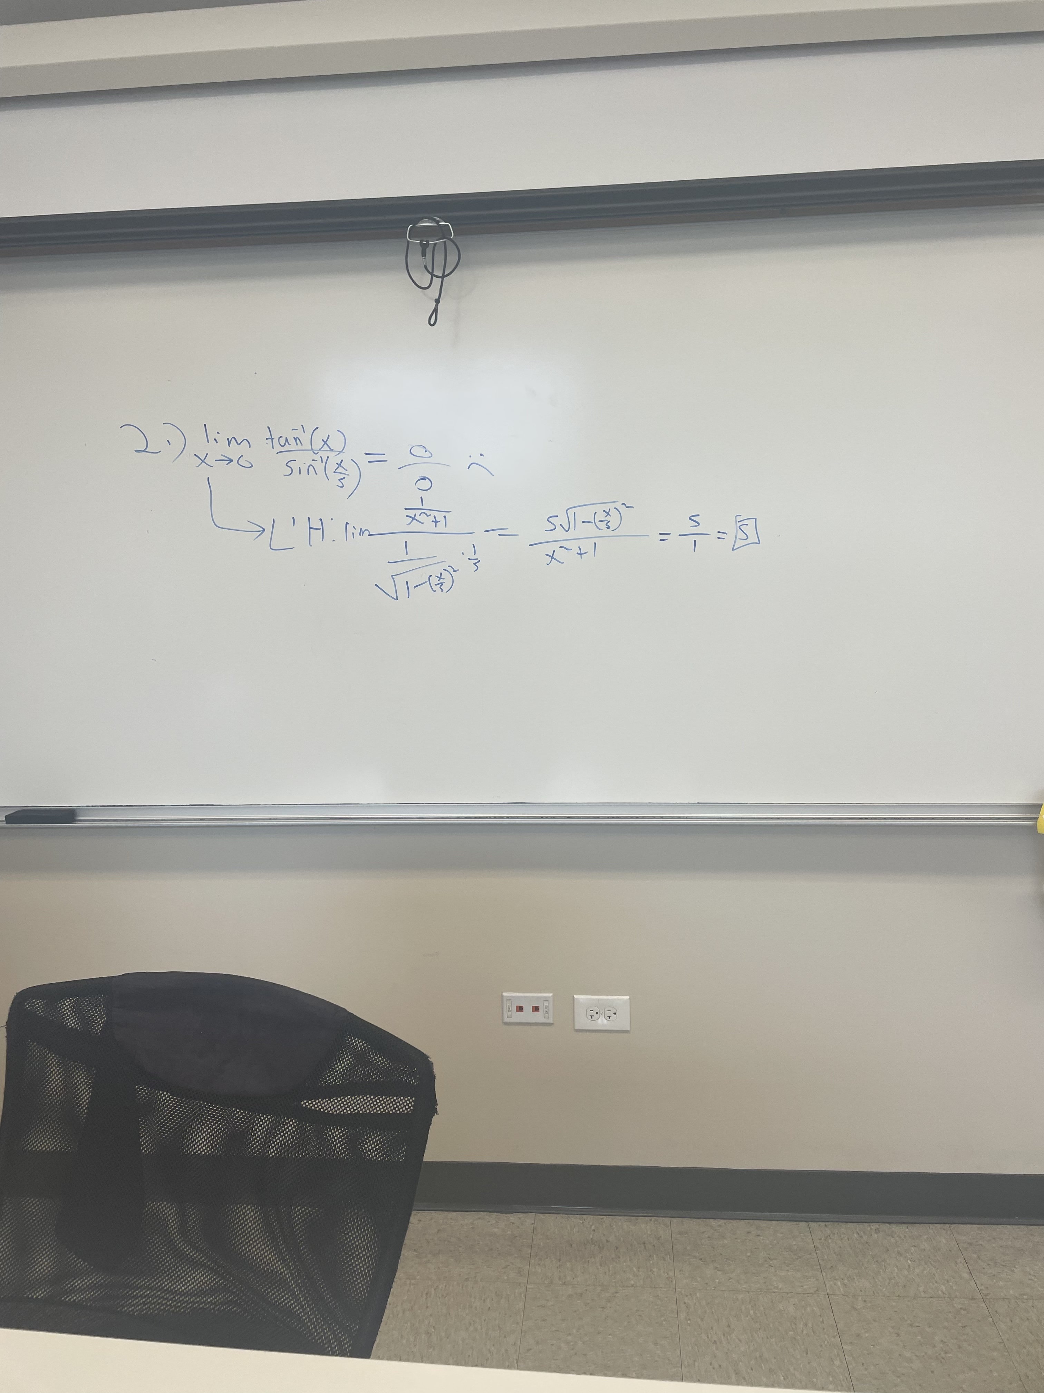
More Limit Practice
1.)

Slide 11
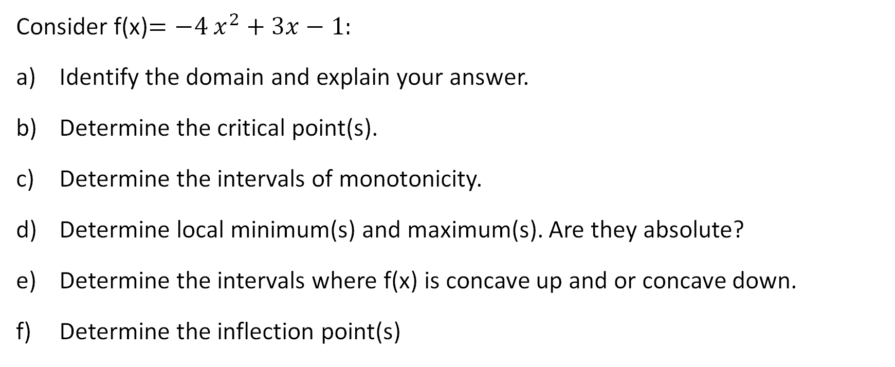
*Q3.) Analyzing Features of a Function
Consider f(x)$=−4$ $x^{2}+3x−1:$
Identify the domain and explain your answer.
Determine the critical point(s).
Determine the intervals of monotonicity.
Determine local minimum(s) and maximum(s). Are they absolute?
Determine the intervals where f(x) is concave up and or concave down.
Determine the inflection point(s)

Slide 12
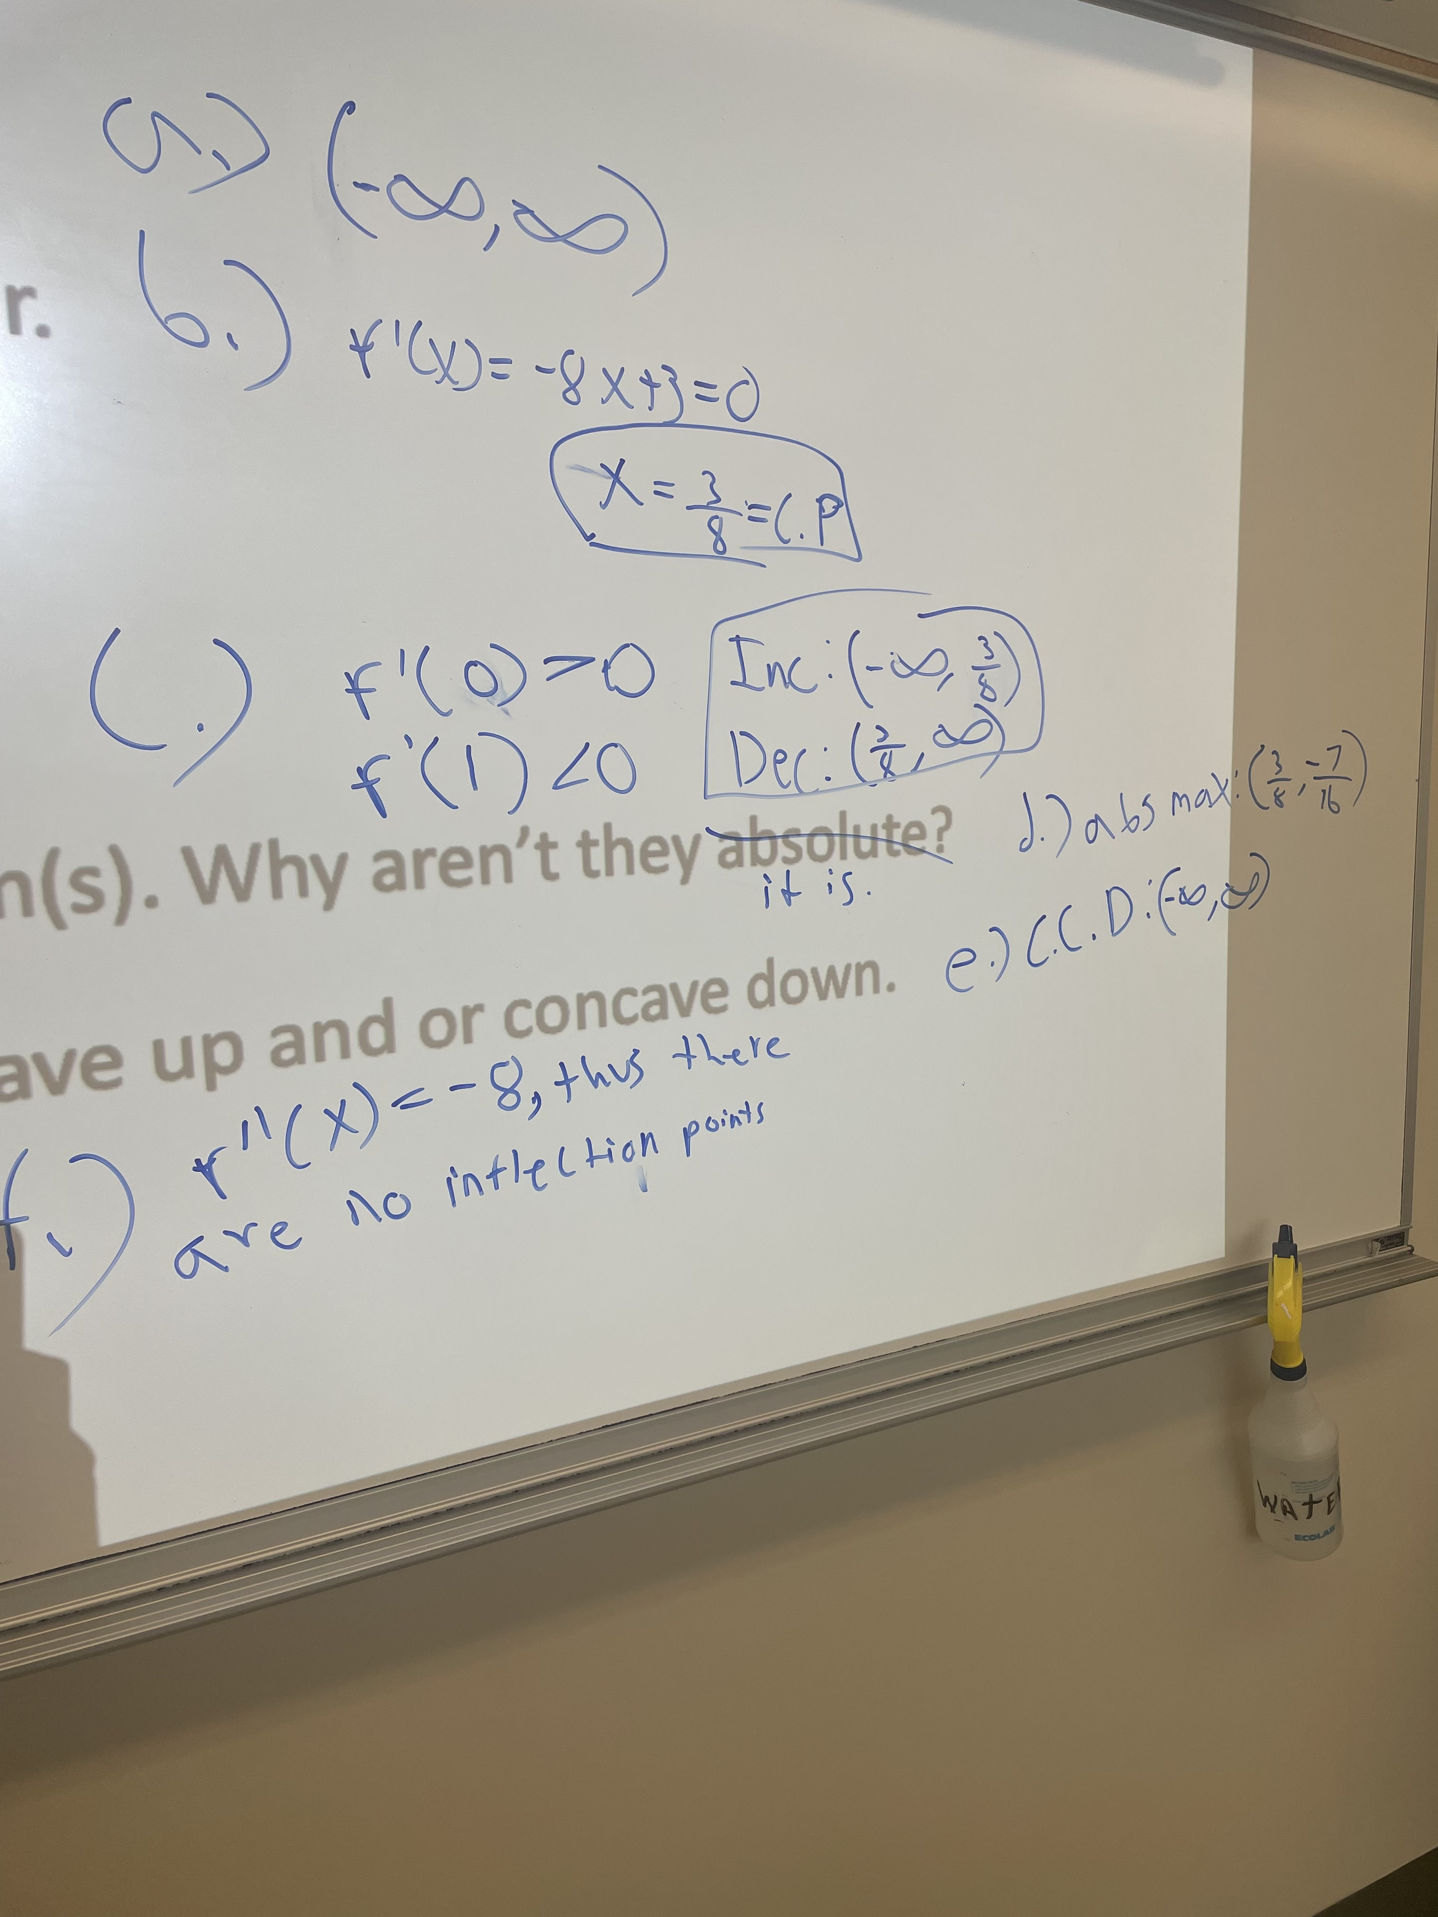
Q3 Answers

Slide 13
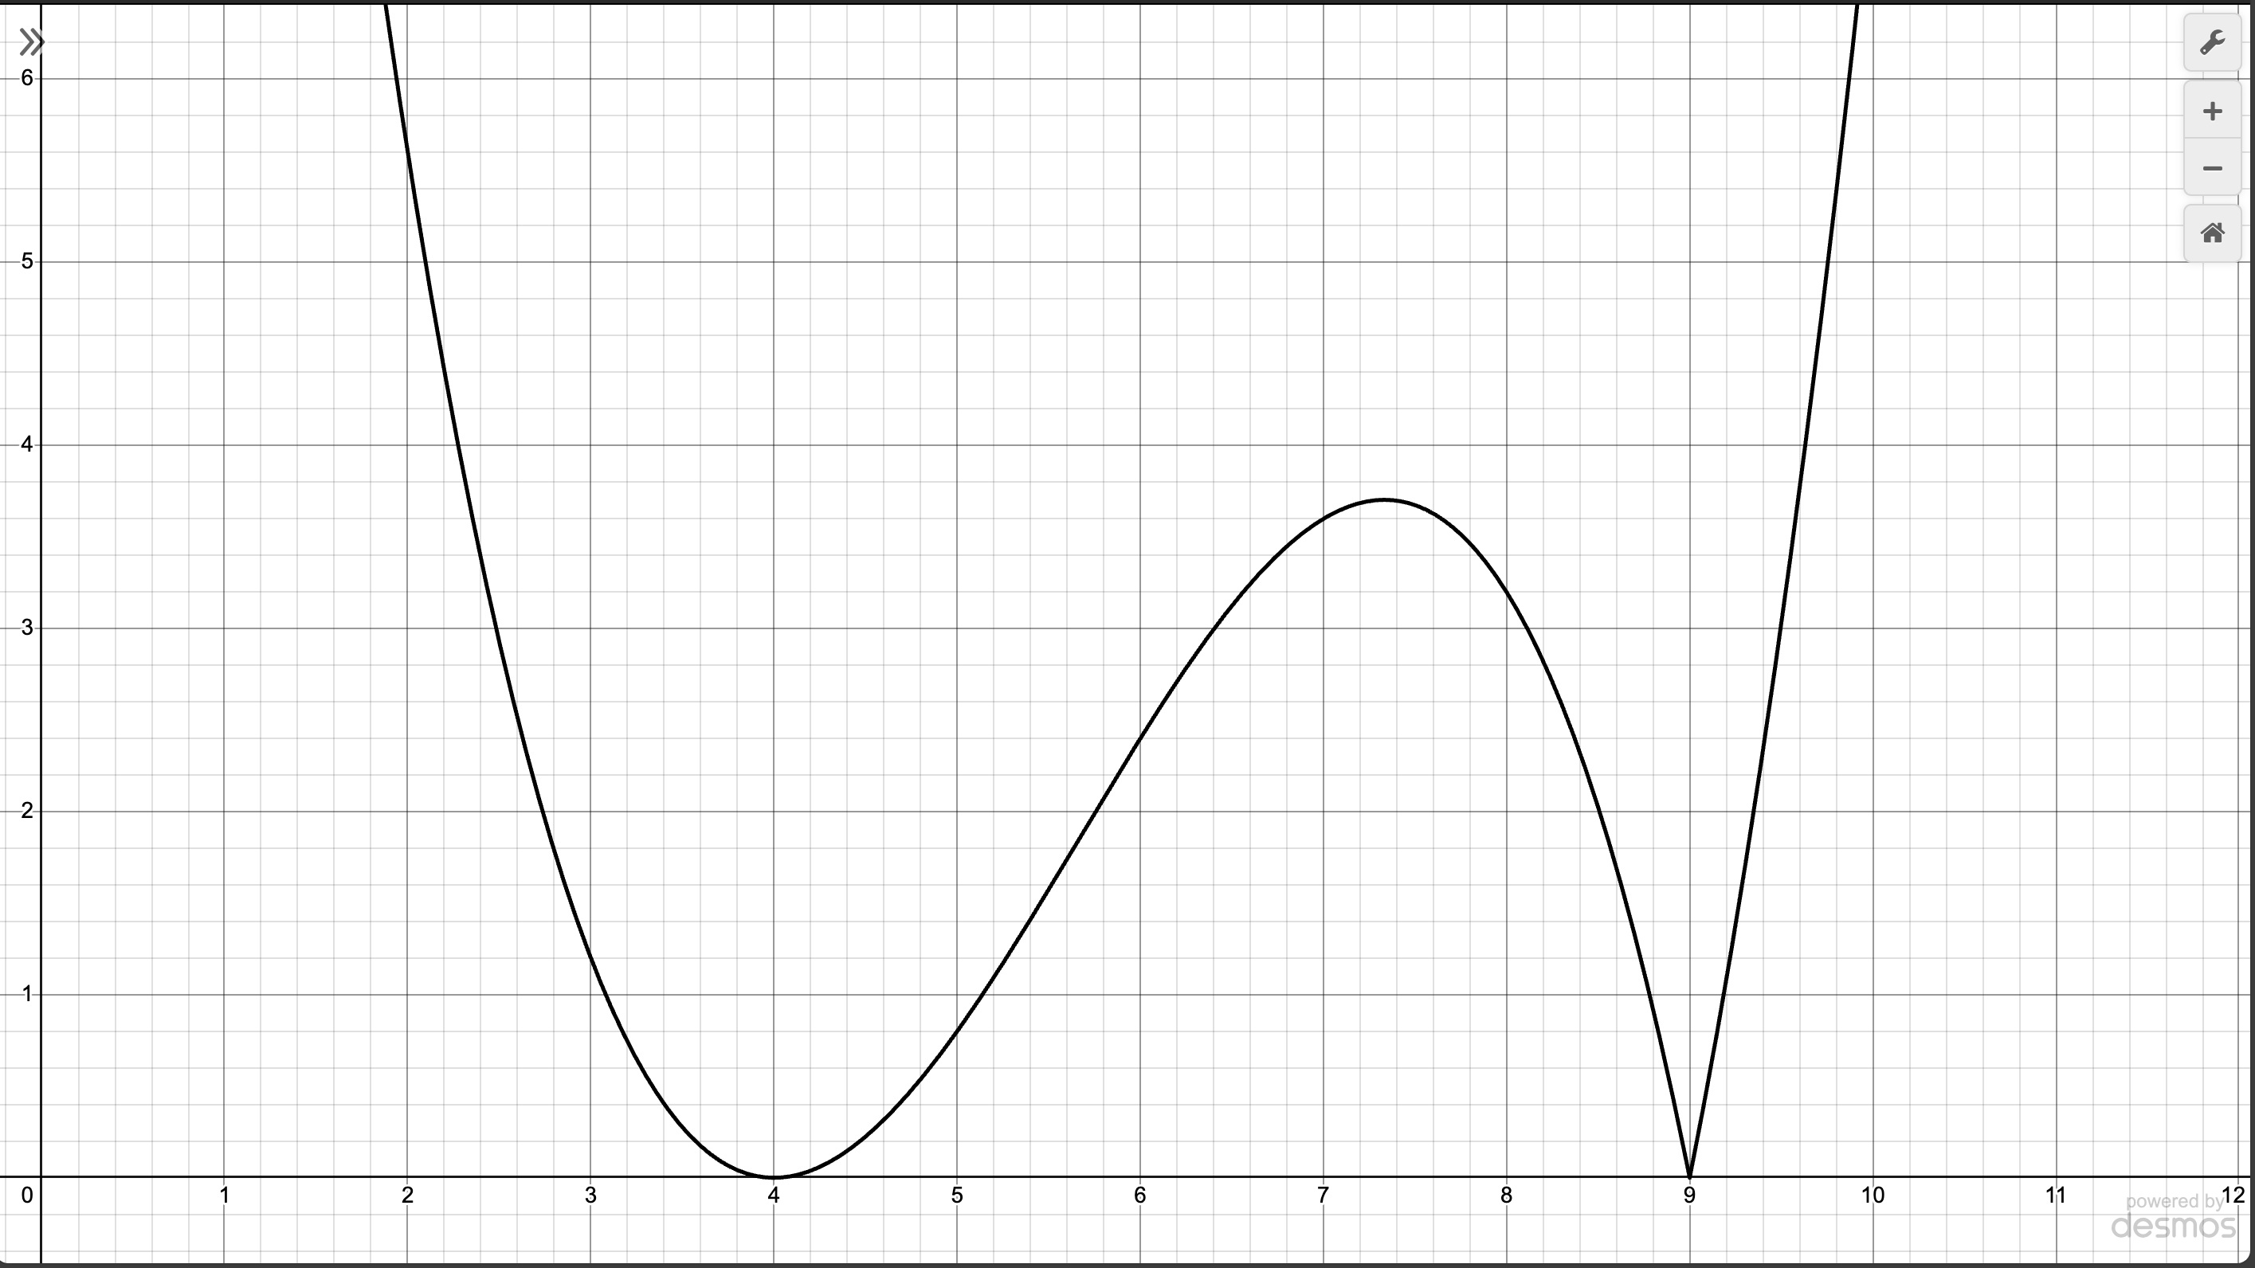
*Q4.) Graphically Analyzing Features of a Function.
Determine the critical points (x-values only), state the value of f’(x) at those C.P’s, and mins and maxes over the interval [2, 10] for f(x).
f(x)

Slide 14
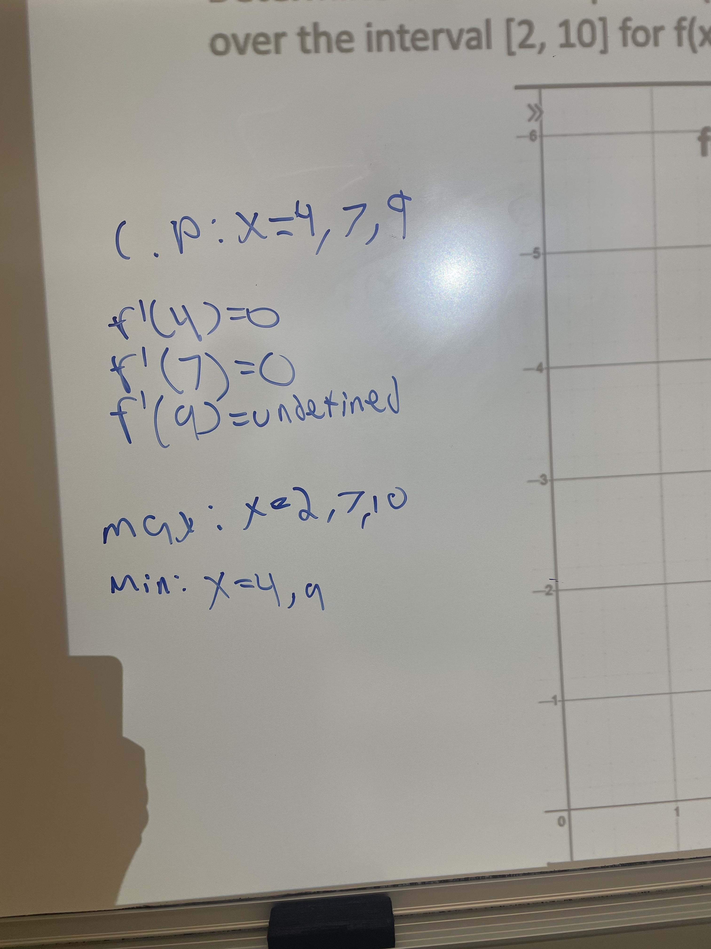
Q4 Answers

Slide 15
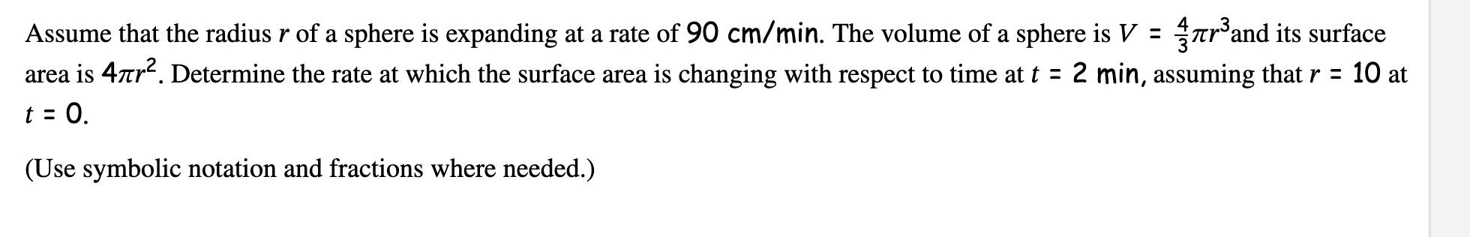
*Q5.) Related Rates - HW 3.10 Q4

Slide 16
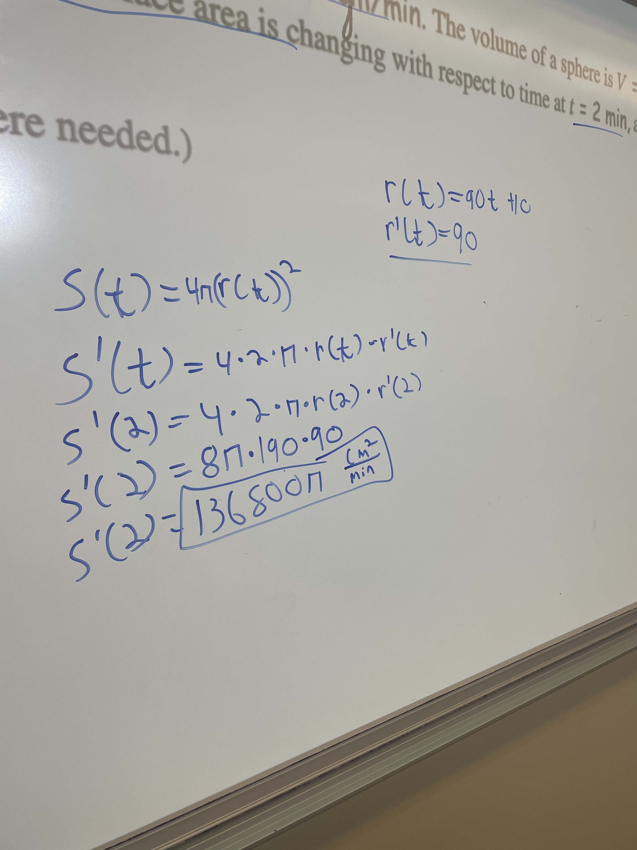
Q5 Answers

Slide 17
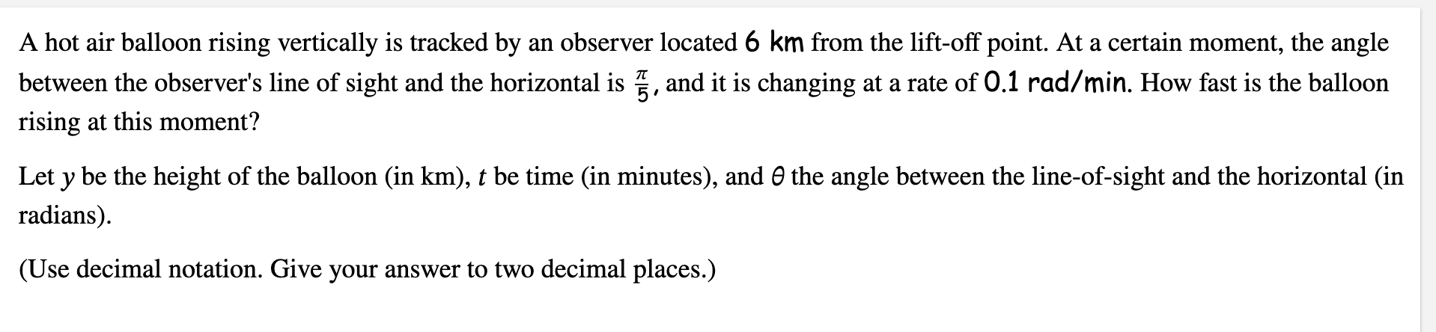
Achieve – HW 3.10 Q10

Slide 18
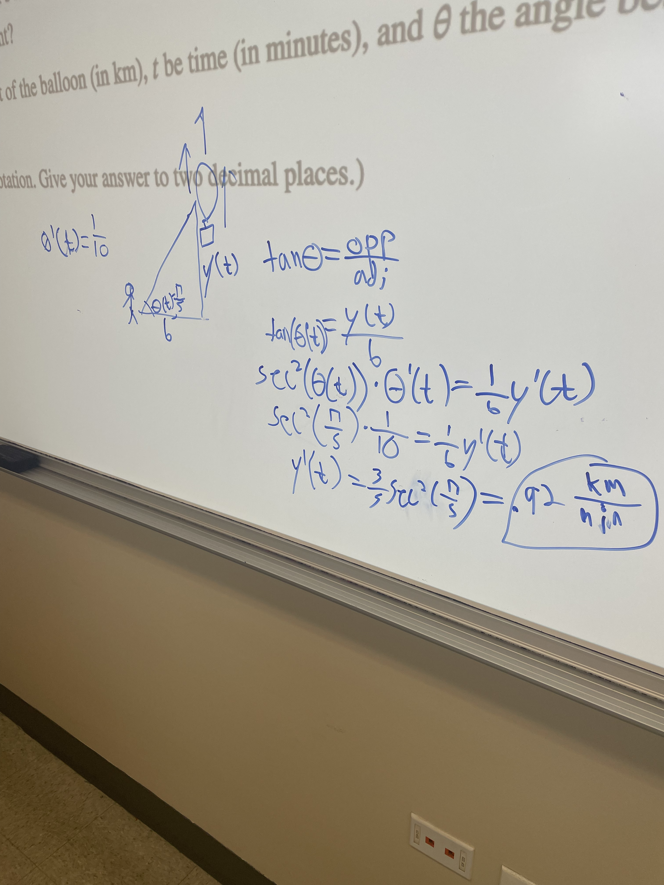
Achieve Q10 Answer

Slide 19
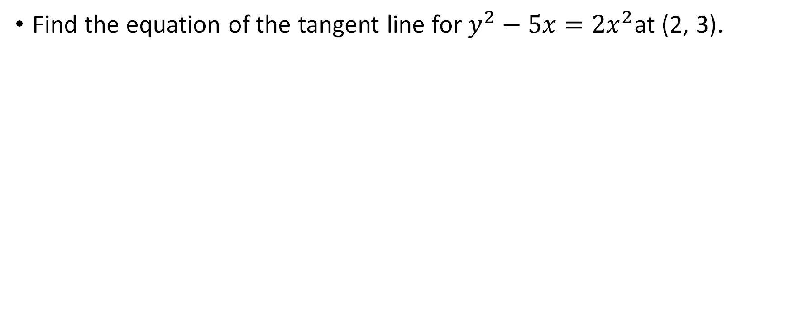
*Q6.) Equation of the Tangent Line
Find the equation of the tangent line for $y^{2}−5x={2x}^{2}$at (2, 3).

Slide 20
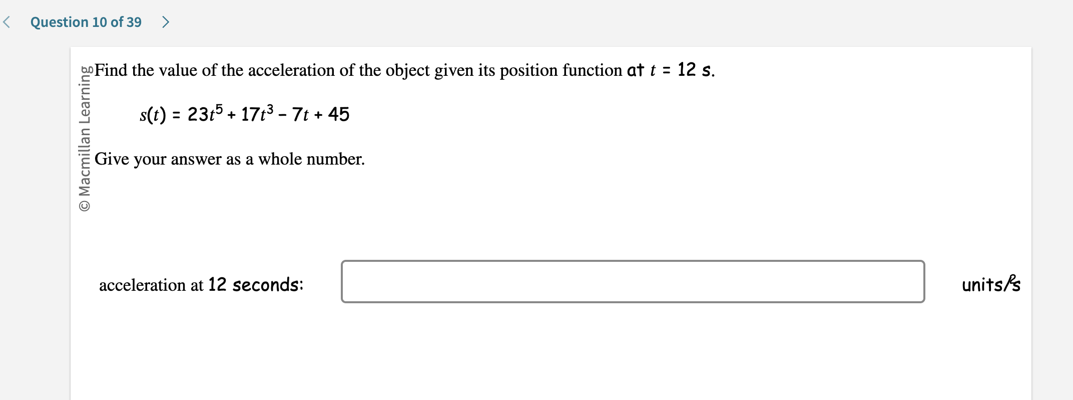
Achieve – Study Guide Q10

Slide 21
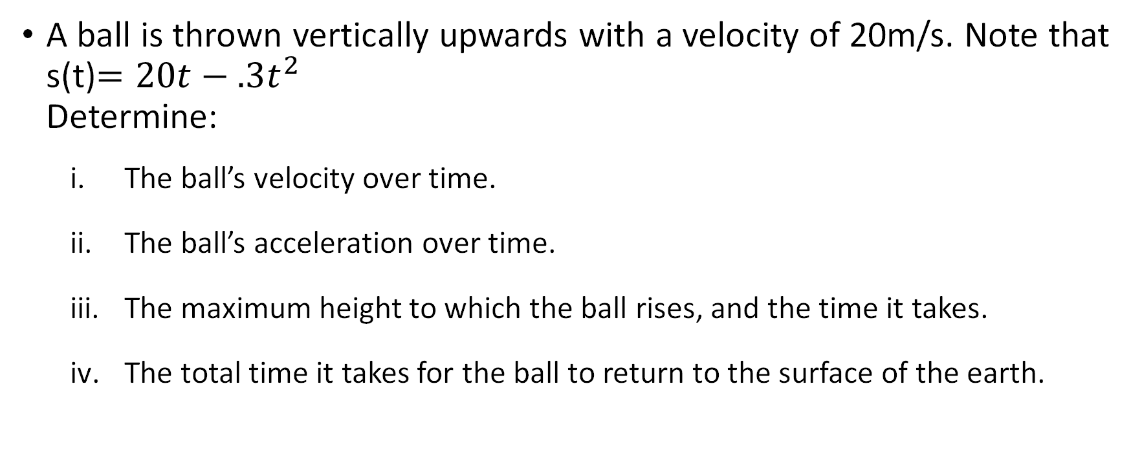
*Q7.) Applications of Calculus
A ball is thrown vertically upwards with a velocity of 20m/s. Note that s(t)$=20t−.3t^{2}$ Determine:
The ball’s velocity over time.
The ball’s acceleration over time.
The maximum height to which the ball rises, and the time it takes.
The total time it takes for the ball to return to the surface of the earth.

Slide 22
Final Reminders!!
If you still need support, ask for help in the GroupMe so your classmates or I can assist!
If you are unable to solve a question, make sure to at least write the formulas/setup for the problem, this will help maximize partial credit!
If variables are different from the norm, e.g t instead of x, use the original variable as given in the problem!
Make sure to include units in your answers on relevant problems! These will typically be application questions like those with related rates.
This PowerPoint contains comprehensive review material, try to at least do the red-starred questions! These will help you prepare the most for your exam.

Slide 23

Good Luck!!
Remember, Math is fun!!
How a certified math enjoyer smiles

